Slide 1
Stack Overflow
Programmer’s social life

Slide 2
StackOverflow – Programmer’s social network
Stack Overflow is a question and answer site for programmers
It started from 2008
More than 10m registered users, more than 16m questions.

Slide 3
Exploring Programmer’s Social Life
What are we exploring
What’s the different behavior between programmer and users in other social network
What affects programmers’ social behavior
Demonstrate the detail
Users analysis by geometry
Age distribution
Contribution to open source
Open source contribution
Years coding distributions
Top 10 popular categories by year and users number participation.
Posts without answers
Draw a conclusion
Programmers also have social life.
Programmers like different thing.
Programmer have their favorite and disagree.
Programmers like to be recognized
Programmer follow trend also
Programmer got disappear some times
Notes:
Through the data, we can see Stackoverflow is a special social networking tool. Programmer like to be recognizedMany programmers participate and contribute.
Programmers also follow hot topics.
Programmers have their favorite and disagreement in different place.
Programmers like technology, technology affect their behaviors
Some programmers really like to share.

Slide 4
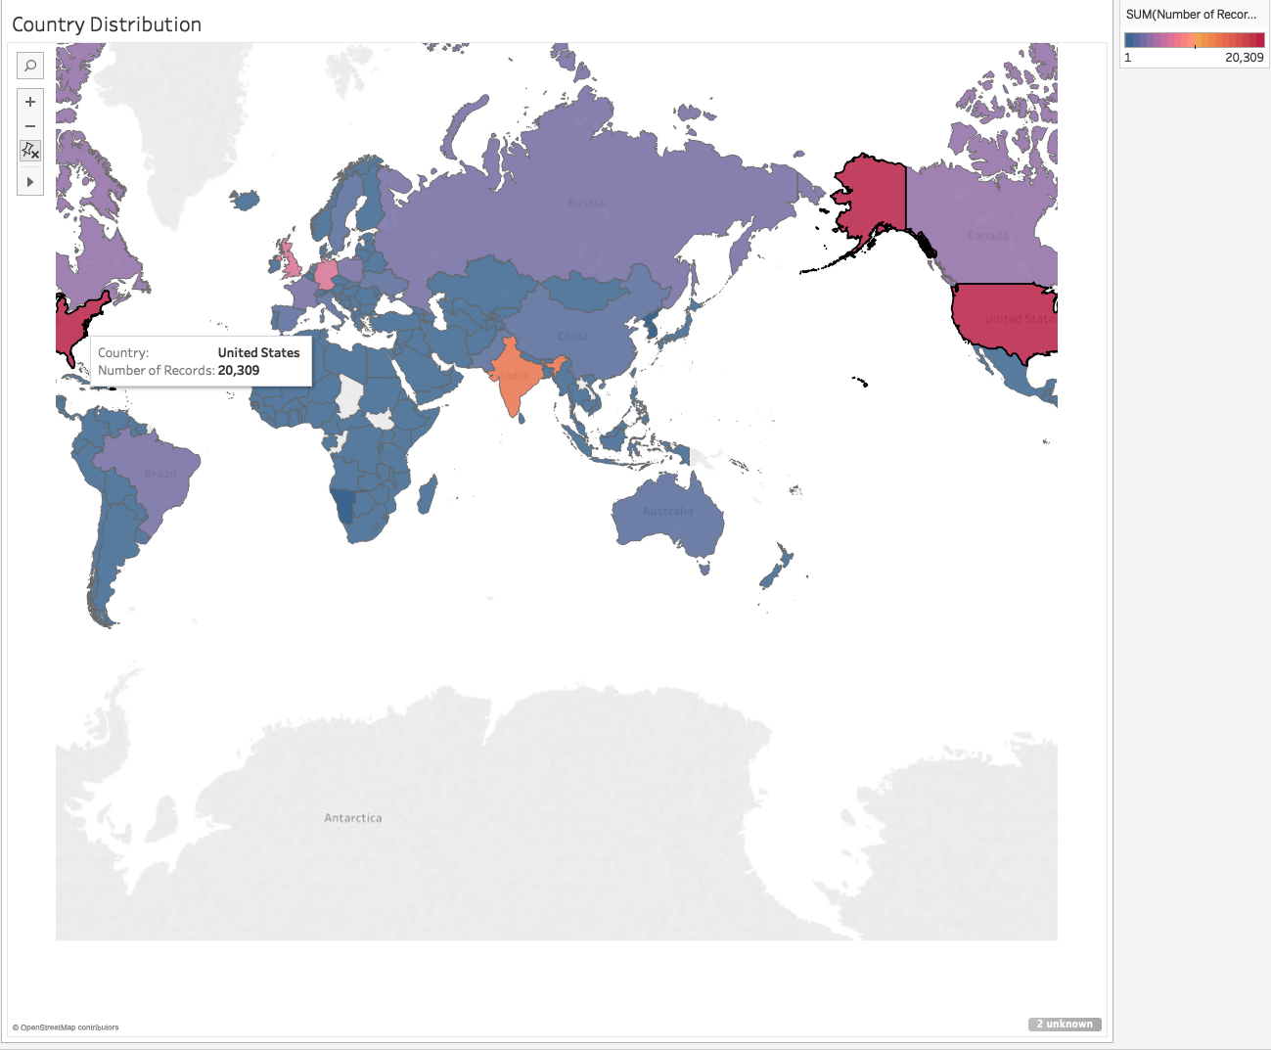
Users by geometry
Notes:
Map

Slide 5
Map Chart Pros & Cons
Pros
It giving a geometry view that different country’s data
It gave the context we are using, like by country or state.
If the focus for data not total country based. But only story-teller only focus top 3 geometries, it can give the audience very straight-forward view.
Notes:
Map

Slide 6
Map Chart Pros & Cons
Cons
It doesn’t give audience the details like the value or ranking
If story-teller wants to give further analysis, like above/beyond average, P90, map chart is not going to help.
Sometimes map is actually misleading and causes to draw the wrong conclusions about data(Eg look at India here you might not know why India has second participants in the world, may be by populations or their IT industry is good)
If story-teller want to focus on data and details, bar chart should be used
Notes:
Map

Slide 7
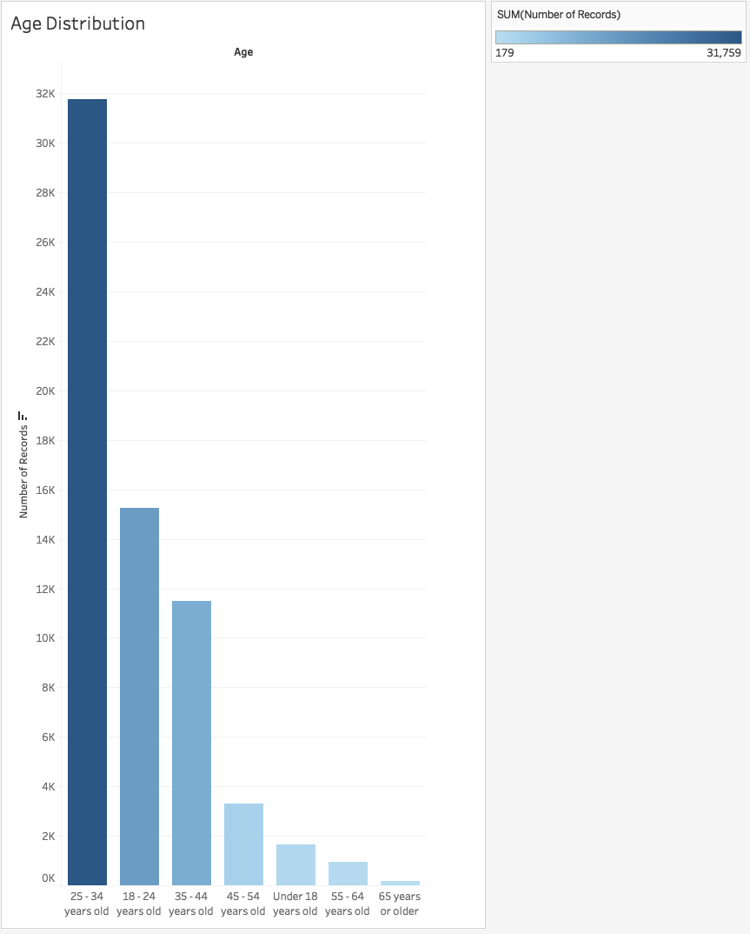

Slide 8
Bar Chart Pros & Cons
Pros
Bar chart is good for categories type’s distribution, it gives intuitive relative relation between the categories for the audience
Bar chart summarizes a large data set by a simplified visual form.
Bar chart can be easily understood.
With using title and axis’s help, bar chart can deliver the central idea of the story.

Slide 9
Bar Chart Pros & Cons
Cons
Bar chart doesn’t give the inside relationship between the category.
Since it’s simplicity, sometimes bar char need more explanation.
Different order of bar chart can express different key point of story, sometimes this could be misleading.

Slide 10
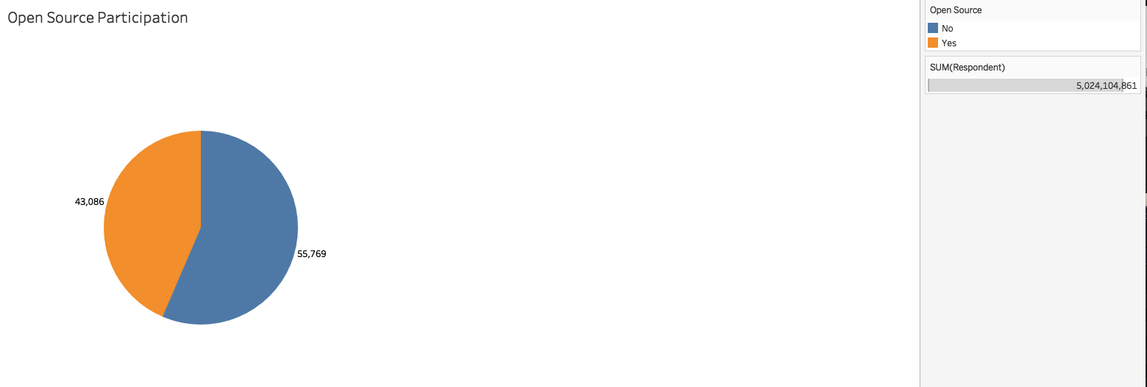

Slide 11
Pie Chart Pros & Cons
Pros
Pie Chart can let audience easily see large disparities when presenting in data.
Pie chart can emphasize data when there are only few units, especially when the number is less than 3.

Slide 12
Bar Chart Pros & Cons
Pros
Pie chart are not good option for comparing more than 5 pieces of data. It’s extremely hard for audience to distinguished among different unit.
Pie chart won’t give audience on the ranking of the data. If the ranking is important, Bar chart is a better option.
If involve with second factor, pie chart is not a good option, in that case, line chart or scatter-plot are better choice.

Slide 14
Line Chart Pros & Cons
Pros
Line chart is good for trend over time.
Line chart shows relationship with a continuous periodical data.
Line chart reflects the change over the time

Slide 15
Line Chart Pros & Cons
Cons
Line only works periodical data
When there are many categories especially more than seven, line chart doesn’t show the real ranking in that case, side by side bar chart may be better.

Slide 16

Redesign
In previous design, map chart was using for country distribution for number of participants.
Color was used to differentiate the numbers, this is not clear
First try to use size instead of color to represent the numbers

Slide 17
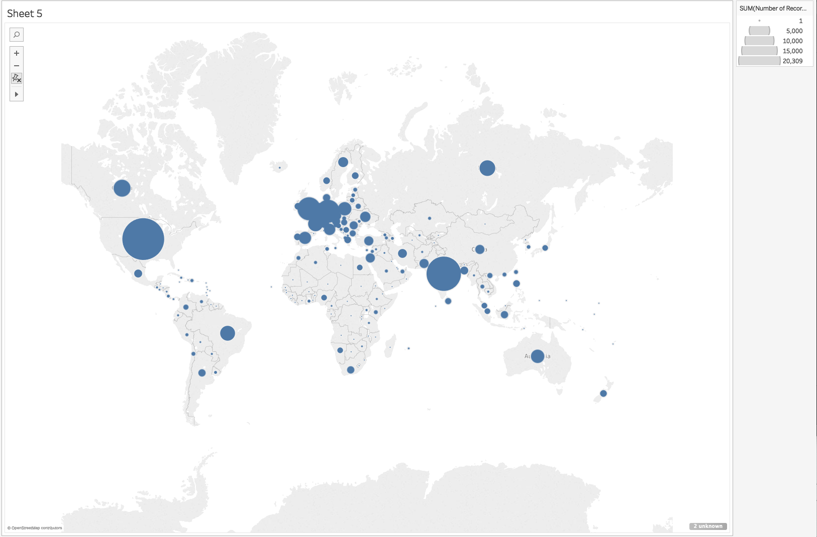
Redesign

Slide 18
Redesign
Map chart can’t reflect the ranking of the country
Size still does not show top N country’s participants
By size, what audience only see the relative size that this could misleading.
Change the chart to horizontal bar chart
Make top 10 participated country with blue and all other countries are grey.
Axis was changed to 5k as span
Top 10 country title was changed to same color as bar color.

Slide 19
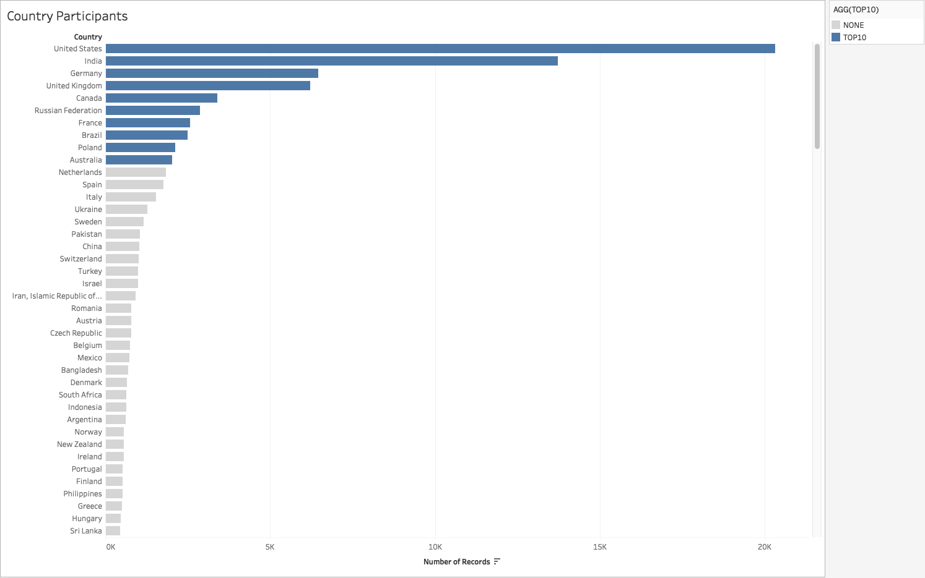
Redesign

